Slide 1
CSCE 313 – Introduction to UNIx process
Reading Reference: Textbook Chapter 2
Aakash Tyagi CSCE 313 Spring 2016
February 4, 2016

Slide 2
Key Learnings: Tue 2/2
DUAL MODE
“Referee” Role of an OS comes with significant responsibilities and capabilities
Enforcing Fairness, Efficiency, and Correctness are perhaps the most critical of the bunch
OS is also a piece of software residing in the same memory so it is the CPU that wears the “referee” hat when it runs the OS Kernel code and wears the “player” hat when running user code
This is called Dual Mode operation

Slide 3
Key Learnings: Tue 2/2
Architectural support for user and kernel modes in CPU execution implies hardware features provided to accomplish dual modes transition, especially
Privileged Instructions
Memory Protection
Timer, etc.

Slide 4
Key Asides
System Call Handling (Ch. 2.6)
How do we execute traps safely and return back cleanly to resume user code?
Interrupt handling (Ch. 2.5)
How do we service an exception that occurs in the middle of running user code and return back cleanly (safely) to resume user code?
How do we boot an OS Kernel? (Ch. 2.9)

Slide 5
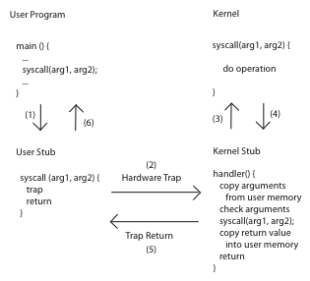
Aside1: Handling System Calls

Slide 6
Aside2: Handling an Interrupt
CPU checks for interrupts after each instruction
Save critical registers on Kernel stack and get in Kernel Mode
Disable Interrupts
Refer to Interrupt Descriptor Table for handler location
Execute handler
save process context
service INT
Enable Interrupts. If no other INT, restore control to interrupted process
Continue on normal program execution

Slide 7
Aside3: PC Booting

Slide 8
Summary: User/Kernel (Privileged) Mode
User Mode
interrupt
FP exception
syscall
rtn
FP Exception error
rfi
Kernel Mode
exit
exec
Limited HW access
Full HW access
Notes:
Processor routinely checks for interrupts and if one is logged, it goes back to save the state of the process it is executing and enters the kernel to service the interrupt. The service is done by entering a interrupt vector table which contains the address of the specific interrupt service routine. Once the routine is serviced the kernel gives control back to the user process.
In multiprocessor systems, only one processor has to service the interrupt from an external device.
What happens when you move a mouse pointer? Each move or point or click registers as an interrupt which is noticed by the processor which moves the control back to the Kernel to service the interrupt routine and that shows up as an action to its associated process (e.g. move of mouse pointer in the active window, or highlight of a word selected, etc.)
An alternative to Interrupt would be “polling” where the Kernel would go in a round-robin fashion to check the status of each device to see if they have an interrupt.

Slide 9
Example: Web Server (Revisited)
syscall
syscall
syscall
RTU
RTU
wait
wait
interrupt
interrupt

Slide 10
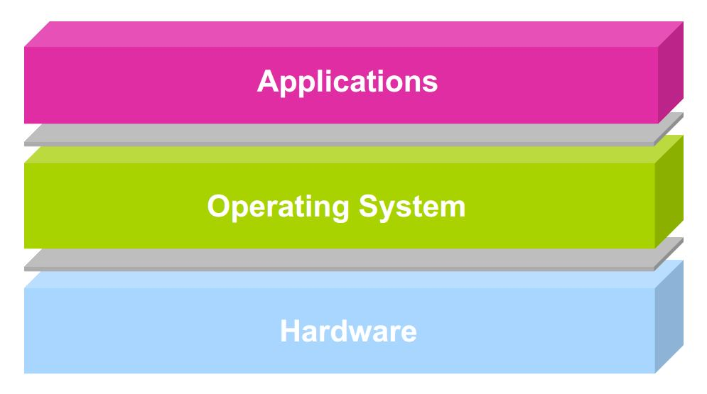
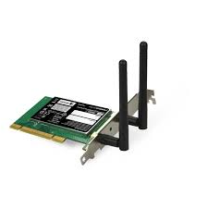



Theme of the rest of our conversation
Unix Process concept and definitions
user2
user3
user1
user2
user3
user4
user1
user4
Application Programs/Processes
return
System calls,
Exceptions
Privileged
Operations
Processor
Memory
INT
Character O/P
Bock I/O
storage

Slide 11
Outline
Process – Program in Action
Address Spaces
Learning about Process with ‘ps’
Miscellaneous questions about Process
Concurrent Processes
Context Switching

Slide 12
Prologue* with Questions
“How does Unix run programs? It looks easy enough: you log in, your shell prints a prompt, you type a command and press Enter. Soon a program runs.
When the program finishes, your shell prints a new prompt. How does that work?
What is the shell? What does a shell do? What does the kernel do? What is a program and what does it mean to run a program?”
* Understanding Linux/Unix Programming, by Bruce Molay

Slide 13
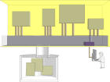
Process is Program in Action
processes
ps
ps –a
ps -l
ls
ls –a
ls -l
files
In Unix terminology
an executable program is a list of machine language instructions and data
a process is the memory space and settings with which the program runs
Data and programs are stored in files on the disk: programs run in processes

Slide 14
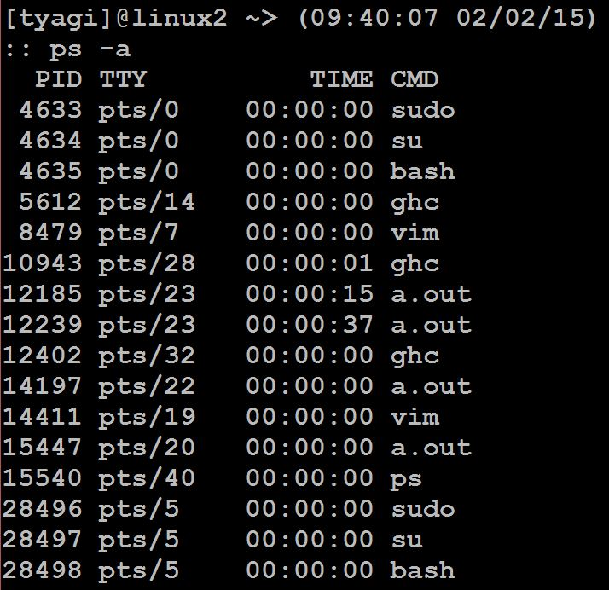
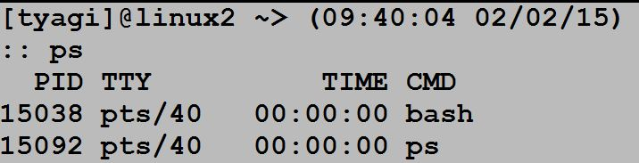
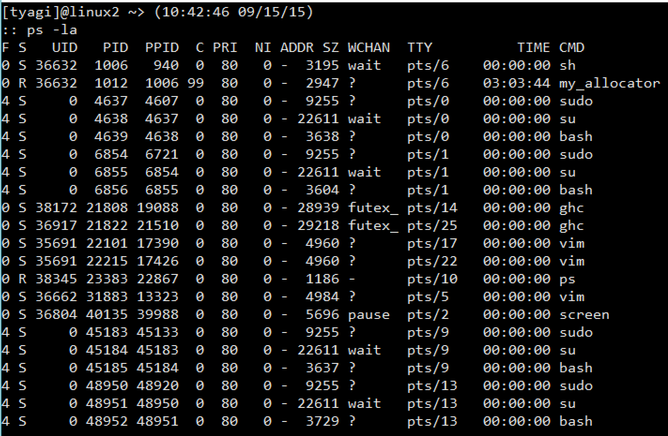
Learning about Processes with ‘ps’
Run these commands in your linux/unix system and then also read the ‘man’ pages
Notes:
F: flags (4 is super-user)
S: Process State (R is Running or Runnable, S is INT sleep, T is stopped)
C: % of CPU
PRI: Priority
NI: Nice Value
ADDR: Memory address - not used
SZ: Size virtual memory usage in pages
Wchan: wait channel where the process is sleeping

Slide 15
Processes
Definition: A process is an instance of a ‘running’ program
Process provides each program with two key abstractions:
Logical control flow
Each program seems to have exclusive use of the CPU
Private address space
Each program seems to have exclusive use of main memory
How are these illusions maintained?
Process executions interleaved (multitasking)
Address spaces managed by virtual memory system

Slide 16
Logical Control Flows
Each process has its own logical control flow
Process A
Process B
Process C
Time

Slide 17
Private Address Spaces
Each process has its own private address space
0xffffffff
user stack
(created at runtime)
%esp (stack pointer)
memory mapped region for
shared libraries
0x40000000
run-time heap
(managed by malloc)
brk
read/write segment
(.data, .bss)
loaded from the
executable file
read-only segment
(.init, .text, .rodata)
0x08048000
0
unused

Slide 18
Process Management and File Management
‘ps’ shows that processes have many attributes
‘ls’ does something similar but for files
The kernel stores several processes in the memory just like it stores files on the disk

Slide 19
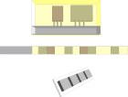
Computer Memory and Programs
Memory can be viewed as an expanse of space containing the kernel and user applications (processes)
Memory as an array of pages and split processes into one or more pages
The array of pages may be stored physically in solid state chips
kernel
process A
process B

Slide 20
Concurrent Processes
Two processes run concurrently (are concurrent) if their flows overlap in time
Otherwise, they are sequential
Examples:
Concurrent: A & B, A & C
Sequential: B & C
Process A
Process B
Process C
Time

Slide 21
User View: Concurrent Processes
Control flows for concurrent processes are physically disjoint in time (except on multi-core machines)
However, we can think of concurrent processes as running in ‘parallel’ with each other
Process A
Process B
Process C
Time

Slide 22
Context Switching
Processes are managed by the kernel
Important: the kernel runs as part of (or on behalf of) user processes
Control flow passes from one process to another via a context switch
Process A
code
Process B
code
user code
kernel code
context switch
Time
user code
kernel code
context switch
user code

Slide 23
Some questions to ponder about processes
How is a process created?
How is a process deleted?
Is there a user process and kernel process
Where do we keep information about a process
Does a process have to run through completion from start to finish or can it be interrupted?

Slide 24
Some questions to ponder about processes
Do processes have priorities?
What are the relationships between multiple processes in a system?
Can we have multiple processes related to the same program? Would multiple processes of the same program share addresses during execution?
How does a program create and run a program?
How does a parent wait for a child to exit?

Slide 25
Key Learnings
Concept and Definition of a Process
Example viewed through UNIX ‘ps’
Process concurrency and context switching
Outlined some questions about processes for forthcoming discussions

Slide 26
Next Lecture
Process Operations and Programming Interface (Chapter 3)
We will also start answering some of the questions posed today

